Slide 1
Shape matching and object recognition using shape contexts
Serge Bolongie, Jitendra Malik, Jan Puzicha
Presenter : Neha Raste

Slide 2
Outline
Introduction
Background
Algorithm
Explanation
Results and Discussion

Slide 3
Introduction
Shape Context
    Global descriptor
    Gives description of other points on an object relative to one.
    Correspondence
    Shape description
    Optimum use of computational resources
    Shape matching

Slide 4
Background
Matching
Feature Based
Eigen Vector
Geometric Hashing
Brightness Based
Correspondence using gray values
Training Decision trees
Silhouette Images
Built-in classifiers

Slide 5
Algorithm
Define Prototype.
Solve correspondences between arbitrary points and prototype.
Use those correspondences to estimate aligning transforms – here Affine.
Compute the vector distance between two shapes as a sum of matching errors between corresponding points.
Match and Label.

Slide 6
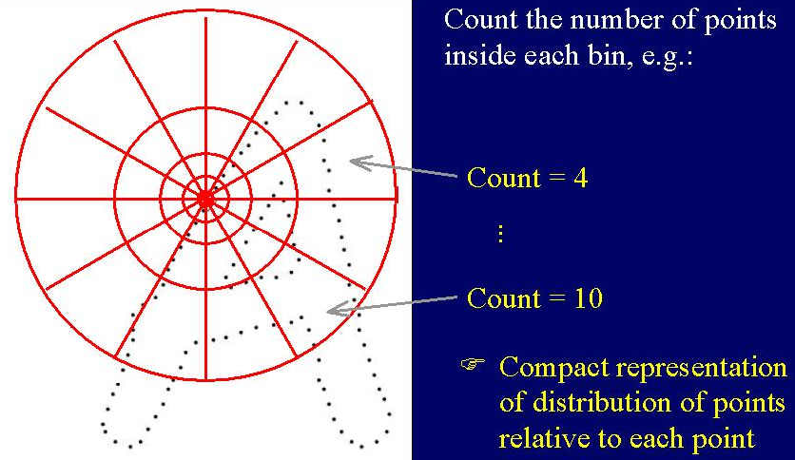
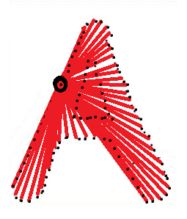
Explanation
Matching with shape contexts – Correspondence Problem - Description

Slide 7
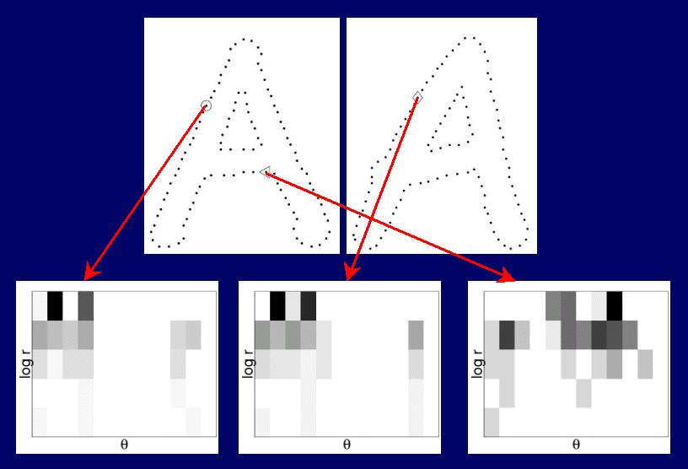

Slide 8

Cost Computation :
C(p_{i}, q_{j}) determined using chi-squared test; which is a form of squared error test.
Determines if the variation of each frequency or bin count is expected or differs from the expectation.

Slide 9

Modeling a Transform :
Affine (Thin Plane Spline)
Measure of Smoothness : By squared error minimization

Slide 10
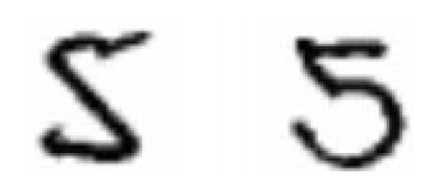
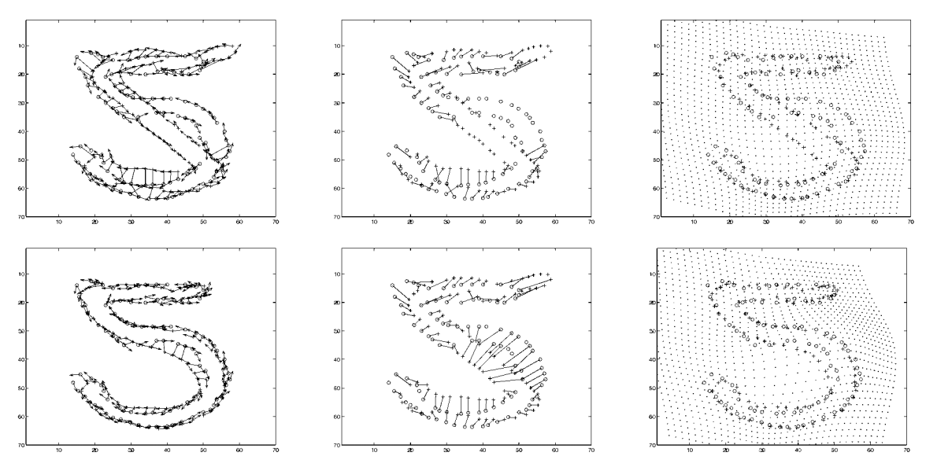

Slide 11
Recognition :
Clustering + Labelling
Clustering : Weighted gray level similarity - to differentiate between different objects, from abstract assignments.
Choose a prototype - needs ‘editing’
Editing – based on ‘shape distance’ and Kmedoids clustering

Slide 12
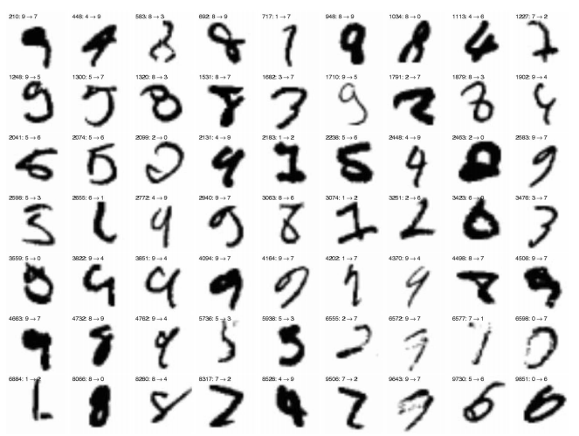

Slide 13
K medoid Algorithm :
Iterate :
{
Find k sets or clusters of abstract points
Find min. distance between protoype and abstract cluster : identify the best prototype using minimum mean dissimilarity.
}
For selection of ‘K’ - Greedy Splitting Strategy

Slide 14
Results and Discussion
Robust Outlier Handling
Scale invariance
Translation Invariance
Independent of illumination variation
Rotation Invariance – ?

